Slide 1
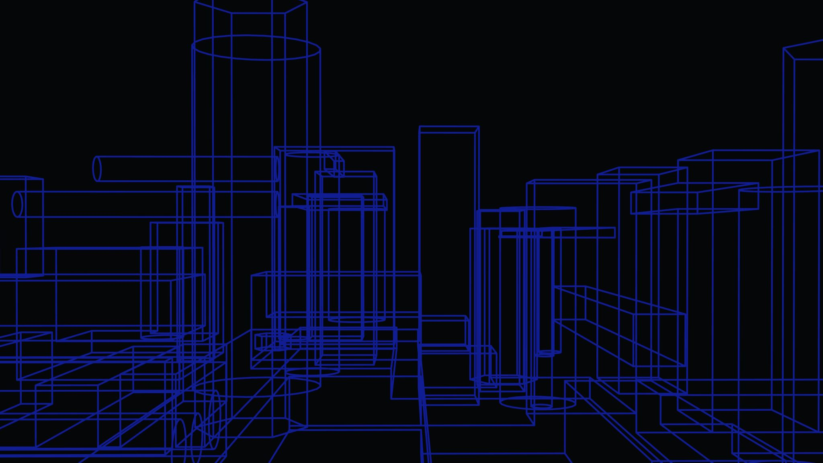
Project Design
By Stuart Goodman

Slide 2
Introduction:
This current presentation will elaborate over the specific design of the project that I am designing.

Slide 3


Premise:
The premise of the application is that the application will be a functional simulation of the SIR model which will be able to be downloaded of a website.

Slide 4

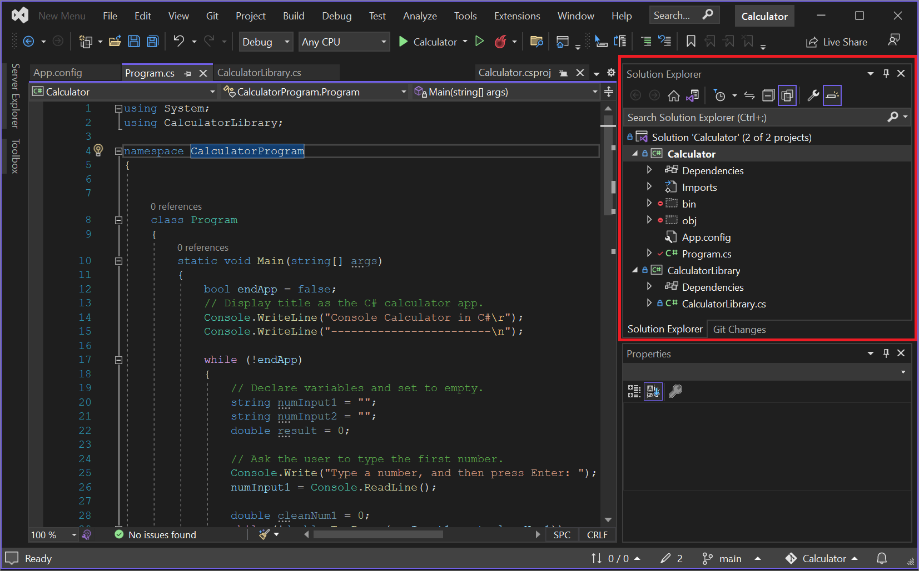
Coding Environment
These are the two possible coding environments that can be used for us. It is not limited to this though, there are multiple that can be used to make sure that the project is abled to be developed.

Slide 5
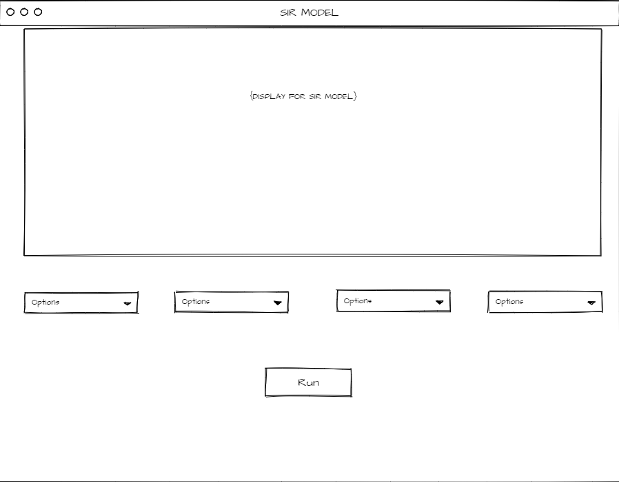
UI
This is the specific temporary outline of the UI that could be used for the project. Obviously, this is not finalized, it is just a temporary outline.

Slide 6
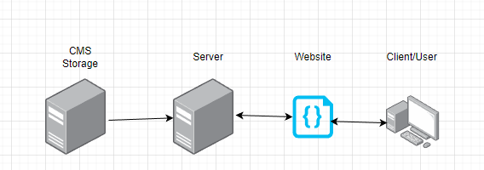
Data
The data will go from my CMS (Content Management System), to the server and then the server will display the data to the client. The client will then be able to send data back for it to be stored.

